Slide 1
FWD Project
TOGAF 9 - Core Diagrams Benefits Diagram Phase E – Opportunities and Solutions

Slide 2
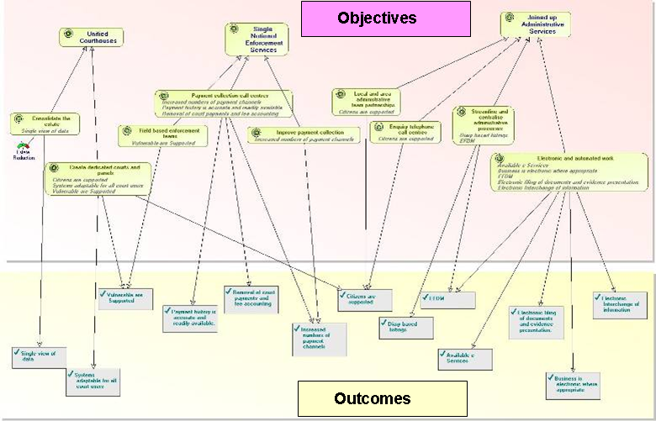
Benefits Diagram

Slide 3
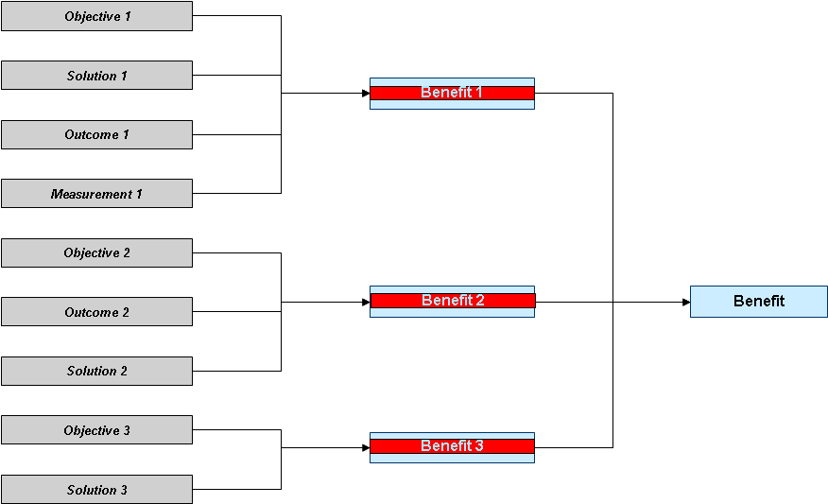
Benefits Diagram

Slide 4
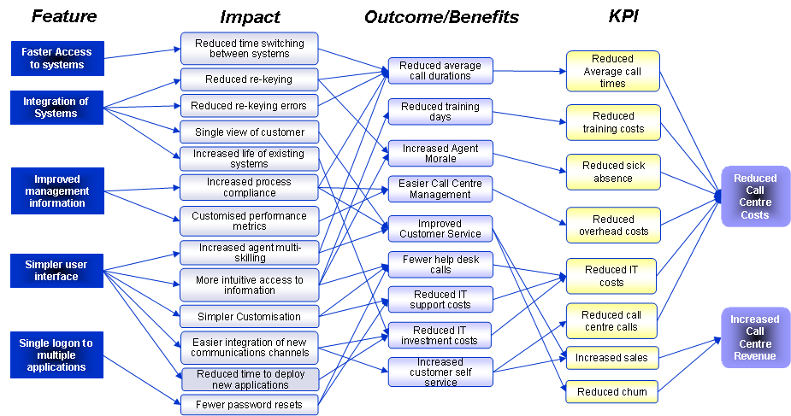
Benefits Diagram

